Slide 1
CLIMATE CHANGE
BY SANDRA

Slide 2
CLIMATE CHANGE DEFINED
Climate change is a long term shift in the average weather conditions of a region, such as it’s typical temperature, rainfall and windiness.
Climate change also refers to a long term shift in temperatures and weather patterns.
Such shifts can be natural due to changes in sun’s activity or volcanic eruptions. Since the human activities have been the main drivers of climate change, primarily due to the burning of fossil fuels like coal, oil and gas.
The burning of fossil fuels generate greenhouse gas emissions that act like a blanket wrapped around the earth, trapping the sun’s heat and raising temperatures.

Slide 3
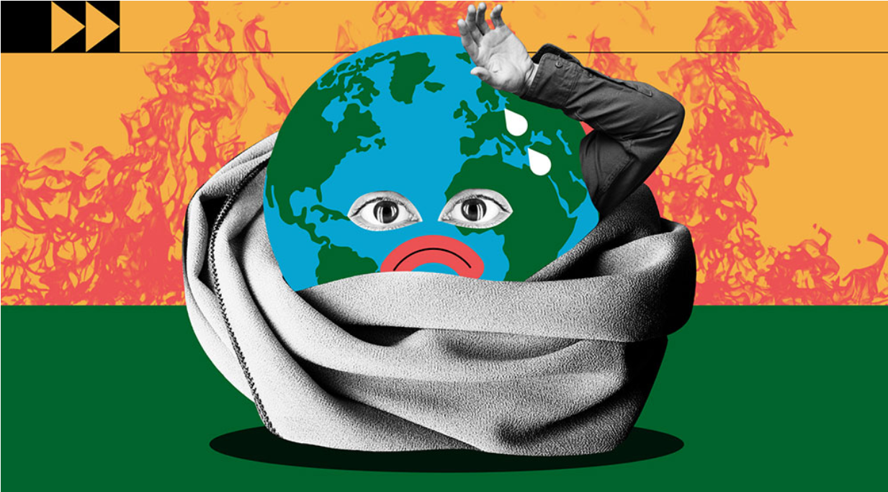
CAUSES OF CLIMATE CHANGE
Greenhouse emissions
As greenhouse emissions blanket the earth, they trap the sun’s heat. This leads to global warming and climate change.
The world is now warming faster than any other point recorded in history. This is as a result of g These come from using gasoline for driving a car or coal for heating a building, clearing land and cutting down trees also releases carbon dioxide.
Agriculture and gas operations are major sources of methane emissions such as carbon dioxide and methane.
.

Slide 4
CAUSES OF CLIMATE CHANGE
Generating power from fossil fuels
Generating electricity and heat by burning fossil fuels such as coal, oil and natural gas causes large chunk of global emissions.
Most electricity is still produced from fossil fuels, only about a quarter comes from wind, solar and other renewable sources.

Slide 5
CAUSES OF CLIMATE CHANGE
Manufacturing goods
Manufacturing and industry produce emissions, mostly from burning fossil fuels to produce energy for making things like cement, iron steel, electronics, plastic clothes and other goods.
Mining and other industries produce gases.
Cutting down trees
Cutting down forests to create farms, pasture and other reasons cause emissions since trees when they are cut, release the carbon dioxide, destroying them also limits nature’s ability to keep emissions out of the atmosphere.

Slide 6
INFLUENCE OF CLIMATE CHANGE ON OUR DAILY LIVES
Climate change affects health, ability to produce (grow food), housing safety and work.
Some of such are already more vulnerable to climate impacts, such as people leaving in small islands and developing countries (Zambia). Conditions like prolonged droughts, floods have advanced to the point where the communities relocate, posing a great danger of famine and other risks to human life.

Slide 7
HOW CAN WE REDUCE THE IMPACT OF CLIMATE CHANGE ON OUR ENVIRONMENT

Slide 8
HOW CAN WE REDUCE THE IMPACT OF CLIMATE CHANGE ON OUR ENVIRONMENT

Slide 9
HOW CAN WE REDUCE THE IMPACT OF CLIMATE CHANGE ON OUR ENVIRONMENT

Slide 10
HOW CAN WE REDUCE THE IMPACT OF CLIMATE CHANGE ON OUR ENVIRONMENT

Slide 11
HOW CAN WE REDUCE THE IMPACT OF CLIMATE CHANGE ON OUR ENVIRONMENT

Slide 12
SOURCE
THE UNITED NATIONS

Slide 13
THE END
THANK YOU FOR YOUR ATTENTION

